Slide 1
Zomato Order & Restaurant Analysis Using Power BI
.

Slide 2
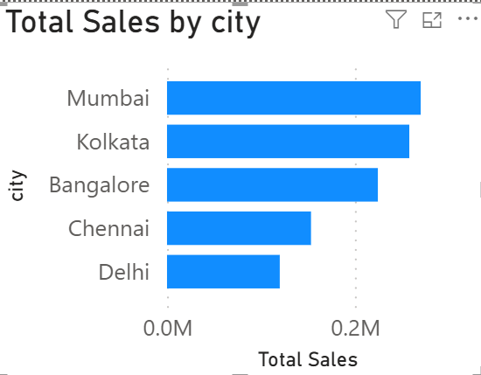
Task 1: Number of Restaurants per City
Mumbai leads sales, making it the strongest revenue-generating city.
Kolkata and Bangalore show strong performance and contribute significantly to total sales.
Chennai records moderate sales, indicating growth potential.
Delhi has the lowest sales, suggesting a need for targeted marketing efforts.
Sales are concentrated in the top 3 cities, highlighting key markets for business expansion.

Slide 3
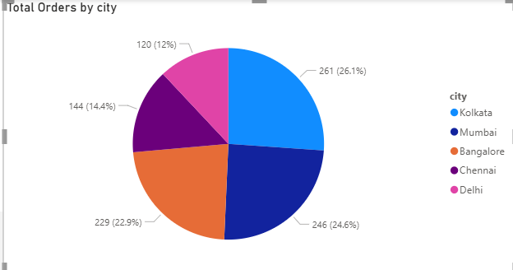
Task 2: Percentage of Orders from Different Cities
Kolkata: 261 orders (26.1%)
Mumbai: 246 orders (24.6%)
Bangalore: 229 orders (22.9%)
Chennai: 144 orders (14.4%)
Delhi: 120 orders (12.0%)

Slide 4
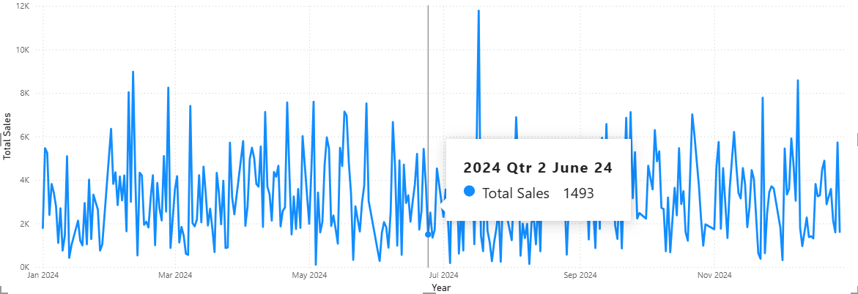
Task 3: Order Amount Trends Over Time
Objective:
High Sales Volatility: Daily sales fluctuate significantly, indicating inconsistent demand.
Event-Driven Performance: Sales spikes suggest promotions, campaigns, or external events strongly influence revenue.
July Peak Opportunity: A major sales surge in July highlights a successful growth trigger worth analyzing and replicating.
Stable Core Demand: Baseline sales remain relatively steady throughout the year, showing consistent customer demand.
Limited Seasonal Impact: No strong seasonal trend is visible, suggesting growth depends more on business initiatives than calendar periods.

Slide 5
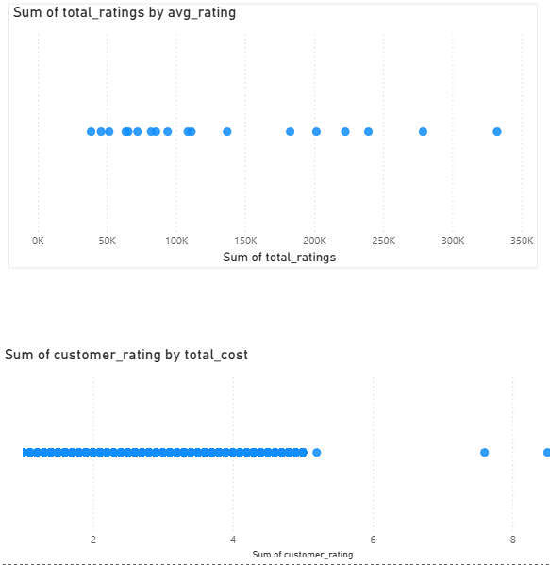
Task 4: Correlation of Factors Affecting Average Rating

Slide 6
Model insights
Broken Sales Chart: Sales visualization appears blank, indicating a possible data model or filter issue.
Incorrect KPI Logic: Customer ratings are summed instead of averaged, leading to misleading insights.
Inflated Satisfaction Scores: High-volume orders artificially boost rating totals.
Outlier Distortion: Extreme data points reflect transaction volume rather than actual customer sentiment.
Data Quality Concern: Dashboard metrics should be validated before making business decisions.

Slide 7
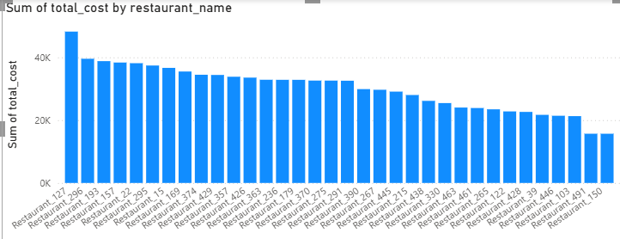
Top 5 Restaurants by Total Sales
Market Leader: Restaurant_127 is the top-performing branch, generating 40k+ sales volume.
Stable Performance: Most branches maintain a consistent sales range of 20k–40k.
Improvement Opportunity: Restaurant_150 and a few other branches lag behind with below 20k sales.

Slide 8
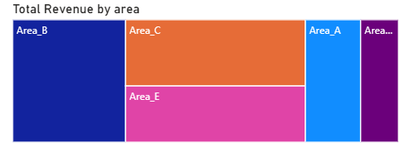
Task 6: Revenue by Area Using a Tree Map
Top Revenue Region: Area_B is the largest contributor to overall revenue.
Strong Supporting Markets: Area_C and Area_E generate significant revenue and support business growth.
Low-Performing Areas: Area_A and other smaller regions contribute the least revenue, indicating growth opportunities.

Slide 9
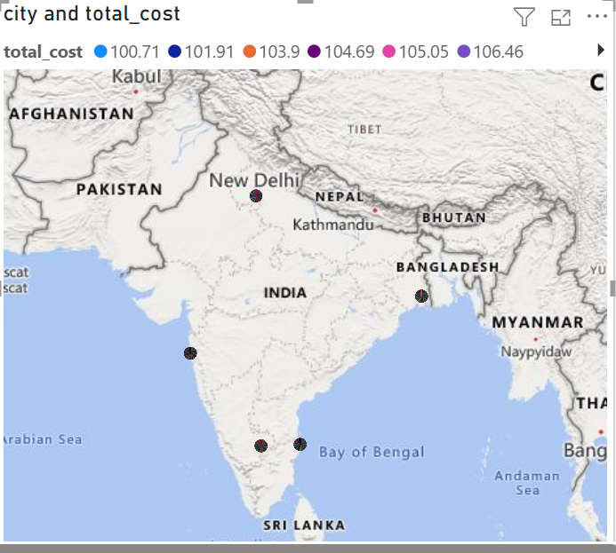
Task 7: Order Density by City Using a Map

Slide 10
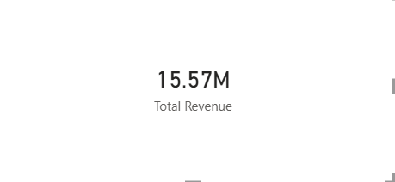
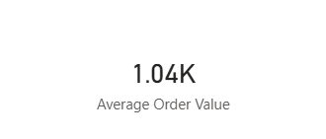
Task 8: KPI Cards – Total Revenue & Average Order Value
High Order Value: Average Order Value (AOV) of 1.04K indicates strong transaction value.
Premium Positioning: Sales suggest premium products, bulk purchases, or B2B transactions.
Strong Revenue Generation: The business has achieved 15.57M total revenue.
Healthy Order Volume: Revenue levels indicate approximately 15,000 orders processed.
Established Customer Base: Performance reflects a stable and growing customer network.

Slide 11
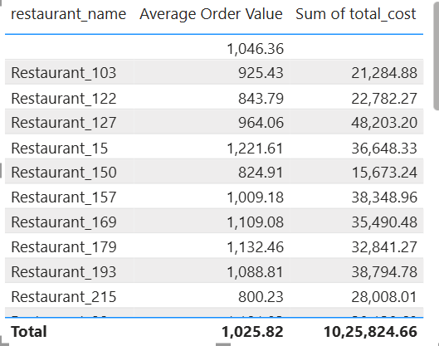
🔹 Task 9: Restaurant-Wise Sales Summary in a Table
Average Order Value is ₹1,026, showing strong customer spending.
A few restaurants drive most revenue, indicating key revenue contributors.
Sales performance varies significantly across restaurants.
High AOV doesn’t always mean high sales, as order volume matters.
Low-performing restaurants offer growth opportunities through targeted promotions.

Slide 12
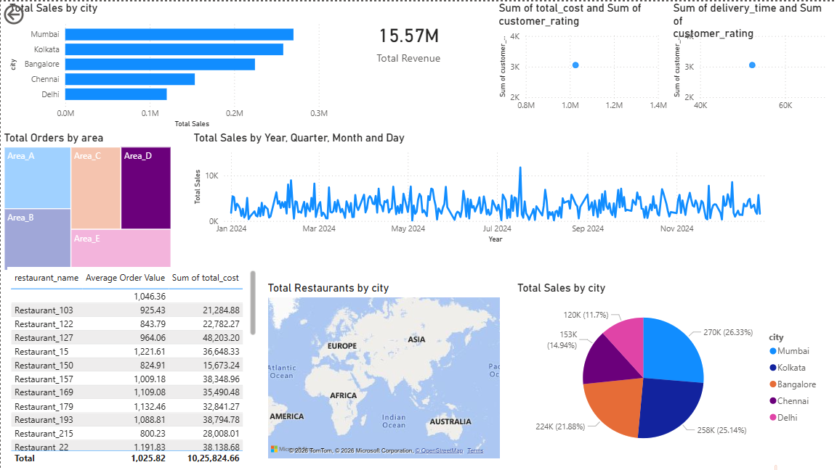
Task 10: Power BI Dashboard – Combining All Visuals

Slide 13
THANK YOU!!

